Slide 1






Alzheimer's Disease Risk Prediction System
A Machine Learning Approach for Early Detection and Risk Assessment
Shady Kishk
Mostafa Ali
Kiroles Emad
Mohamed Sherif
Amr Ahmed
Team Leader
Data Scientist
ML Engineer
Validation Lead
Deployment Engineer
DEPI - Data Science & AI Track
November 30, 2025
10/14/24
‹#›

Slide 2







Problem Statement
Alzheimer's disease and related dementias pose a significant global health challenge, affecting over 50 million people worldwide. Current diagnostic methods are severely limited.
Diagnostic Cost
Waiting Time
Accessibility
$1,000-3,000
6-12 months
Limited Rural Access
Expensive procedures that many cannot afford
Long delays for crucial early intervention
Healthcare disparities in remote areas
Our solution: an ML-based clinical assessment tool to address these challenges.
10/14/24
‹#›

Slide 3












Project Objectives
Our primary goal is to develop an effective, accessible, and cost-efficient solution for Alzheimer's risk prediction.
Build Predictive Models
Deploy Web Application
Develop models with accuracy exceeding 90%
Create a production-ready web platform for clinical use
Explainable AI
Reduce Costs
Provide transparent predictions to foster trust and clinical utility
Decrease diagnostic expenses by 99%
Traditional
Our Solution
↓
99% Reduction
$1,000-3,000
$0-7/month
10/14/24
‹#›

Slide 4














Dataset Overview
Our dataset comprises clinical assessments from 2,149 patients, including 35 health features across multiple categories.
Patient Count
Health Features
Class Distribution
2,149
35
Balanced
Demographics
Lifestyle
Age
BMI
Gender
Smoking Status
Ethnicity
Physical Activity
Medical History
Cognitive Assessments
Hypertension
MMSE (Mini-Mental State Examination)
Diabetes
Memory Complaints
Cardiovascular Disease
ADL (Activities of Daily Living)
10/14/24
‹#›

Slide 5



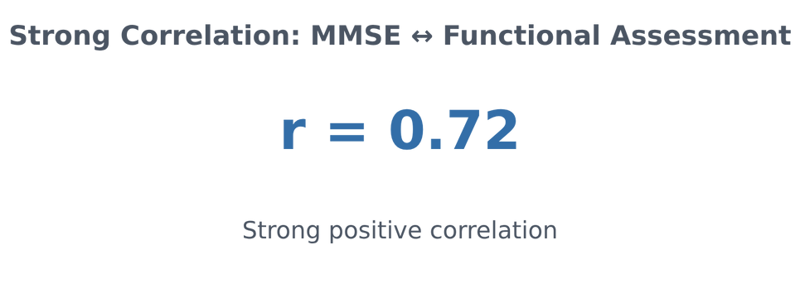





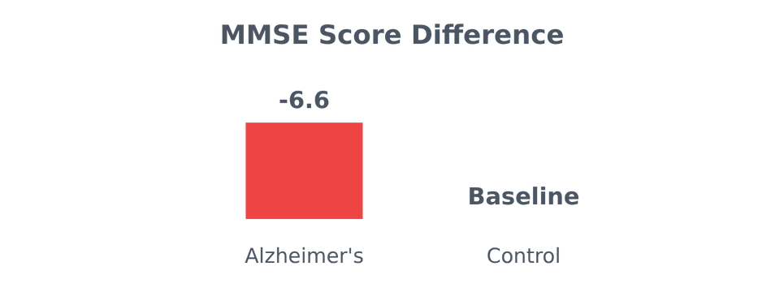


Exploratory Data Analysis
Key insights from the dataset analysis:
Key Correlations
Age Difference
Alzheimer's patients are 1.6 years older on average
MMSE Score
6.6 points lower in Alzheimer's group
Physical Activity
1.8 hrs/week less in Alzheimer's patients
10/14/24
‹#›

Slide 6






Statistical Analysis
Statistical validation confirmed significant differences between patient groups.
Parametric Tests
Non-parametric Tests
T-tests for continuous features
Chi-square for categorical features
ANOVA for education effect
28 out of 35 features significant
Feature
Test
P-value
Effect Size
MMSE Score
T-test
<0.001
Cohen's d = 1.89
Functional Assessment
T-test
<0.001
Cohen's d = 1.45
Memory Complaints
Chi-square
<0.001
Cramér's V = 0.38
Family History
Chi-square
<0.001
χ² = 156.4
Physical Activity
T-test
<0.001
Cohen's d = 0.52
10/14/24
‹#›

Slide 7












Data Quality & Preprocessing
Ensuring data quality and applying appropriate preprocessing is crucial for model performance.
No Missing Values
Outlier Detection
Normalization
SMOTE Balancing
Dataset verified to contain no missing values.
IQR method used to identify and handle outliers.
StandardScaler applied for feature normalization.
Implemented for 1:1 class ratio after balancing.
Train/Test Split
Feature Engineering
80/20 stratified split for training and testing.
All features clinically validated, no synthetic features needed.
10/14/24
‹#›

Slide 8


















Model Architecture
Machine Learning Pipeline
Raw Data
Preprocessing
SMOTE
Model Training
Prediction
Algorithms Tested
Hyperparameter Tuning
Logistic Regression
GridSearchCV with 5-fold Cross-Validation
Baseline model (89.3% accuracy)
Best Parameters for Random Forest:
Random Forest (SELECTED)
n_estimators: 200
Best performance (94.75% accuracy)
max_depth: 20
min_samples_split: 2
Gradient Boosting
class_weight: balanced
Alternative tested model
Cross-validation accuracy: 96.98% ± 0.43%
10/14/24
‹#›

Slide 9




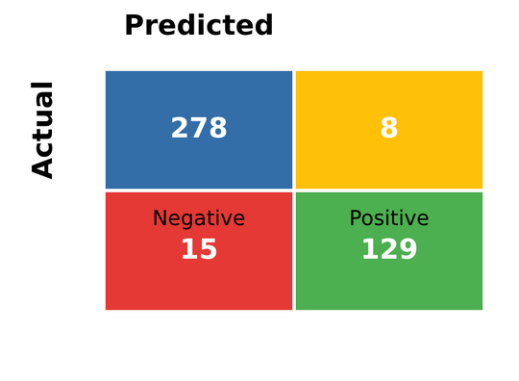




Model Performance
Random Forest model achieved 94.75% accuracy and 97.31% ROC-AUC, outperforming the logistic regression baseline.
Confusion Matrix
Metrics Comparison
Metric
Random Forest
Logistic Regression
Accuracy
94.75%
89.3%
ROC-AUC
97.31%
88.5%
Precision
92.3%
87.1%
Recall
89.7%
82.4%
F1-Score
90.9%
84.6%
True Negatives
True Positives
278
129
Prediction Speed
15ms
8ms
False Negatives
False Positives
15
8
10/14/24
‹#›

Slide 10



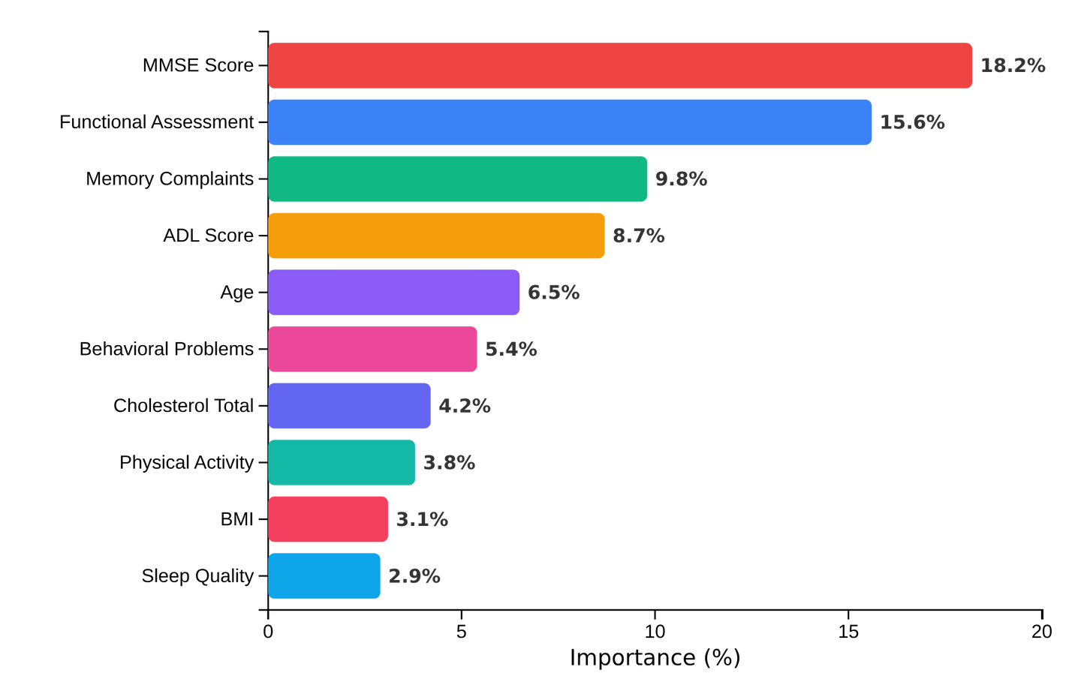




Top 10 Most Important Features
Key Predictors
MMSE Score (18.2%)
Lower scores indicate higher risk. Clinically validated cognitive assessment.
Functional Assessment (15.6%)
Measures daily activities capability. Strong predictor of risk.
Why This Matters
Feature importance helps identify which clinical factors most influence risk prediction. These factors have clinical validity and can be used for early intervention.
10/14/24
‹#›

Slide 11












Model Optimization
GridSearchCV
Best Parameters
Hyperparameter tuning with 5-fold cross-validation.
n_estimators
max_depth
200
20
Results
Trees in forest
Tree depth limit
96.98% ± 0.43%
Accuracy across all folds
min_samples_split
class_weight
2
balanced
Split threshold
Handle imbalance
SHAP Explainability
Benefits
Transparent model decisions
Waterfall plots for predictions
Force plots for feature contributions
10/14/24
‹#›

Slide 12









Application Architecture
Frontend
Backend
ML Models
Deployment
Dash/Bootstrap
Python + Callbacks
Random Forest
Render.com
32-field form
SHAP integration
Logistic Regression
DigitalOcean
Technology Stack
Frontend
Backend
ML & AI
Deployment
Dash 2.14+
Python 3.9+
Scikit-learn 1.3+
Procfile (Render)
Plotly
Flask
SHAP 0.43+
app.yaml (DO)
10/14/24
‹#›

Slide 13


















Core Features
Real-time Risk Prediction
SHAP Explainability
AI Medical Chatbot
32-field clinical assessment
Waterfall plots showing contributions
Google Gemini 1.5 Flash integration
Instant prediction in 15ms
Individual prediction breakdowns
Context-aware medical assistant
4-tier risk stratification
Force plots for visual interpretation
Real-time patient query responses
PDF Auto-Fill
Clinical Reports
Dark/Light Mode UI
OCR-based medical record parsing
Downloadable PDF reports
Persistent user preferences
Automatic field population
Patient data + risk assessment
Bootstrap-styled theme switching
PyMuPDF + pytesseract integration
SHAP plots embedded
Optimized for clinical environments
10/14/24
‹#›

Slide 14








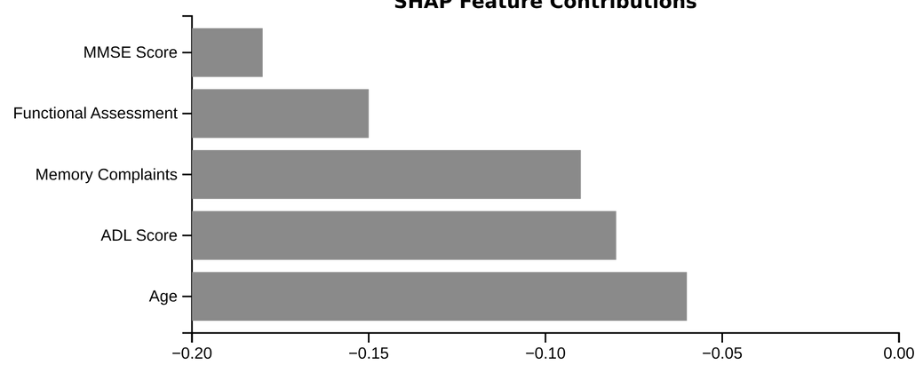

Input Form
Prediction Result
Name: John Doe
Age: 75
Gender: Male
Education: 16 years
32 clinical fields organized into 6 sections
LOW
MODERATE
HIGH
CRITICAL
SHAP Visualization
PDF Report
Patient: John Doe
Date: 2025-12-01
Risk: High
MMSE: 24/30
Functional: 75%
Download complete report with SHAP visualization
10/14/24
‹#›

Slide 15




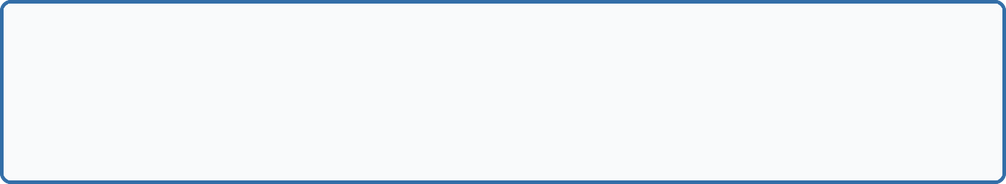














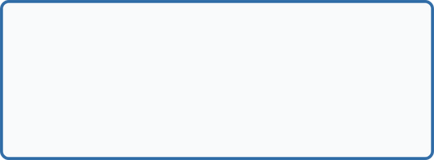
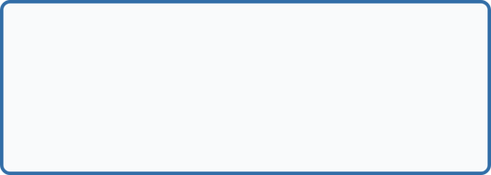






Live Demo
1
Patient Data Input
2
Risk Prediction
Clinical Assessment Form
Results Dashboard
Demographics
Lifestyle
Medical History
75% Risk
75-100%: Critical
Clinical
Cognitive
Review
MMSE: 26
Age: 78
75ms
32 clinical fields
Instant prediction with 4-tier risk
3
SHAP Explainability
4
Chatbot & Report
SHAP Explanation
AI Medical Chatbot
PDF Report
What is MMSE?
Mini-Mental State Exam
MMSE
Functional
Memory
ADL
Age
AI assistant + downloadable reports
Waterfall plots showing feature contributions
Demo URL:
Live demo limitations
Scan to visit
alzheimers-prediction-demo.onrender.com
10/14/24
‹#›

Slide 16








Validation & Quality Assurance
Our rigorous 6-point validation framework ensures model reliability and clinical utility.
Cross-Validation
Test Set Eval
Statistical Testing
5-fold stratified CV
430 held-out patients (20%)
28/35 features significant (p<0.05)
Accuracy: 96.98% ±0.43%
Accuracy: 94.75%
Data Leakage
Dual-Model
Production
Single-feature AUC analysis
Model A: Pre-screening
Edge case handling
Model B: Diagnostic support
Performance benchmarking
NO OVERFITTING PROOF: Test accuracy (94.75%) ≥ Training accuracy.
10/14/24
‹#›

Slide 17











Project Impact
Our ML-based solution dramatically improves access to Alzheimer's screening.
Metric
Traditional Method
Our ML Solution
Improvement
Cost
$1,000-3,000
$0-7/month
99.7%
Time
6-12 months
15 seconds
99.99%
Access
Urban hospitals only
Global (internet only)
100%
Better Explainability
Early Detection
Primary Care
SHAP visualizations vs. black box imaging
Pre-symptomatic possible vs. late-stage only
Empowered primary care physicians
10/14/24
‹#›

Slide 18












Challenges & Lessons Learned
Throughout the project, we encountered four major challenges that required innovative solutions.
Class Imbalance
Feature Correlation
1,400 negative vs 749 positive cases
Cognitive features highly correlated
Solution: SMOTE oversampling
Solution: Statistical validation + dual-model
Result: Balanced precision/recall
Result: Proved no data leakage
Model Interpretability
Deployment Complexity
Random Forest = black box
Multiple dependencies (Dash, SHAP, Gemini)
Solution: SHAP integration
Solution: Docker + cloud deployment
Result: Clinically meaningful features
Result: Stable production environment
Key Lessons Learned:
Thorough EDA prevents modeling issues
Cross-validation prevents overfitting
User feedback drives better design
Documentation enables reproducibility
10/14/24
‹#›

Slide 19












Future Enhancements
Expanding the Alzheimer's Disease Risk Prediction System with strategic improvements.
Short-term (3-6 months)
Long-term (1-2 years)
Clinical Trial Validation
Multi-Class Staging
Partner with memory clinics for prospective studies.
Predict severity and MCI detection.
Multi-Language Support
Longitudinal Tracking
Translate UI to Arabic, Spanish, and French.
Patient history dashboard with change detection.
Mobile App Version
EHR Integration
Native apps for iOS/Android with offline capabilities.
HL7 FHIR API compatibility for clinical workflows.
FDA approval pathway: Class II medical device application with clinical validation studies.
10/14/24
‹#›

Slide 20















Thank You & Q&A
Project Achievements
Team Contact Information
97.31% ROC-AUC (Exceeded 95% target)
Shady Kishk
Mostafa Ali
94.75% Accuracy (Exceeded 90% target)
Team Leader
Data Scientist
Production web app with 6 core features
shadykishk77@gmail.com
Explainable AI with SHAP visualizations
99.7% cost reduction ($1,500 → $3.50)
Kiroles Emad
Mohamed Sherif
99.99% time reduction (6 months → 15 seconds)
ML Engineer
Validation Lead
Repository & Resources
Amr Ahmed
GitHub: Full source code
Live Demo
Deployment Engineer
Project Report
Research Paper
10/14/24
‹#›

